Slide 1
Getting started with the Digital Service Standard
Introductory training

Slide 2
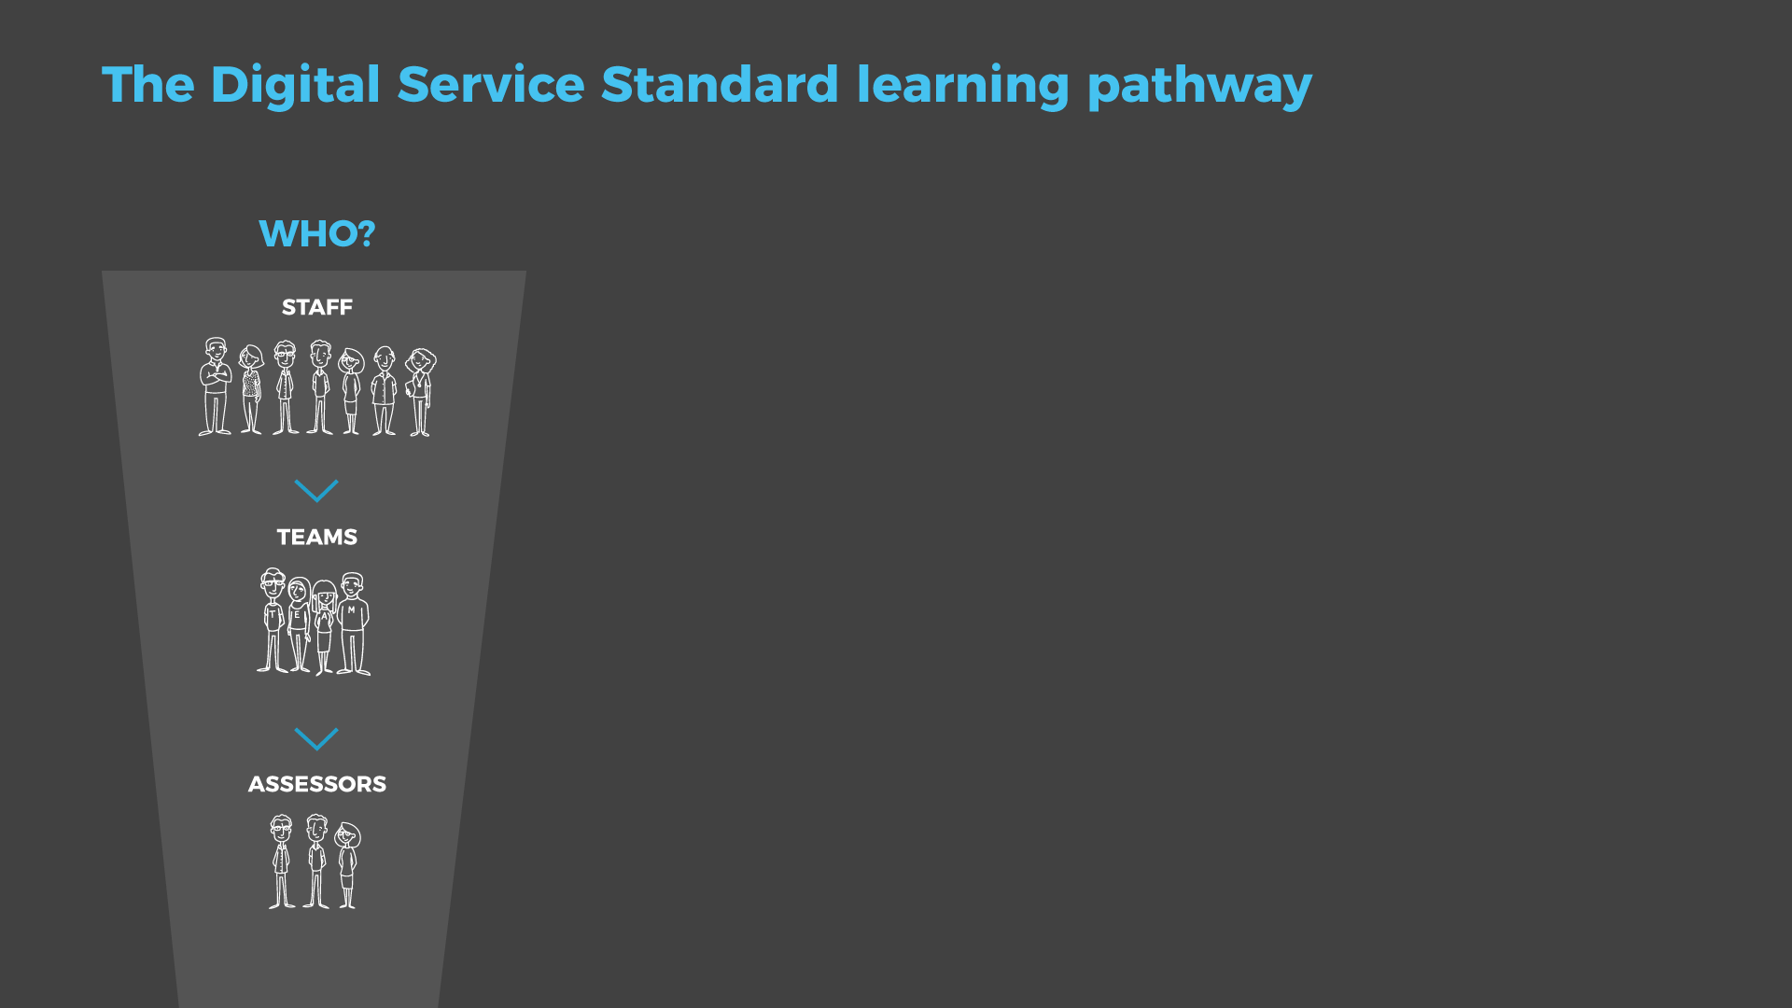



Slide 3
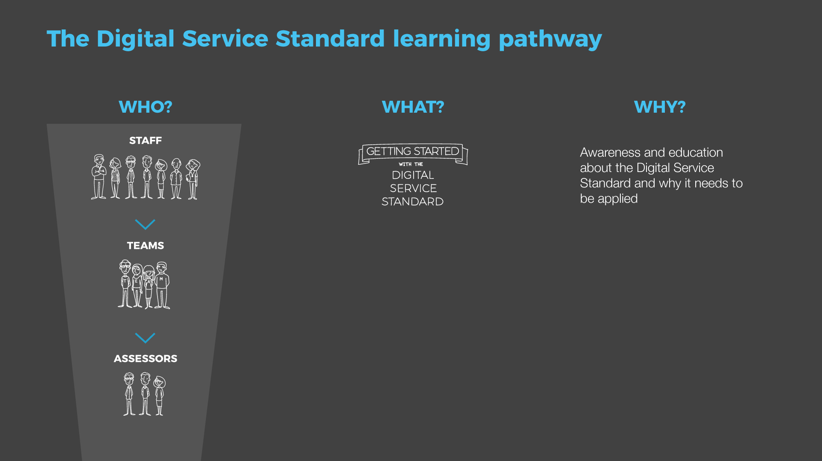

Slide 4
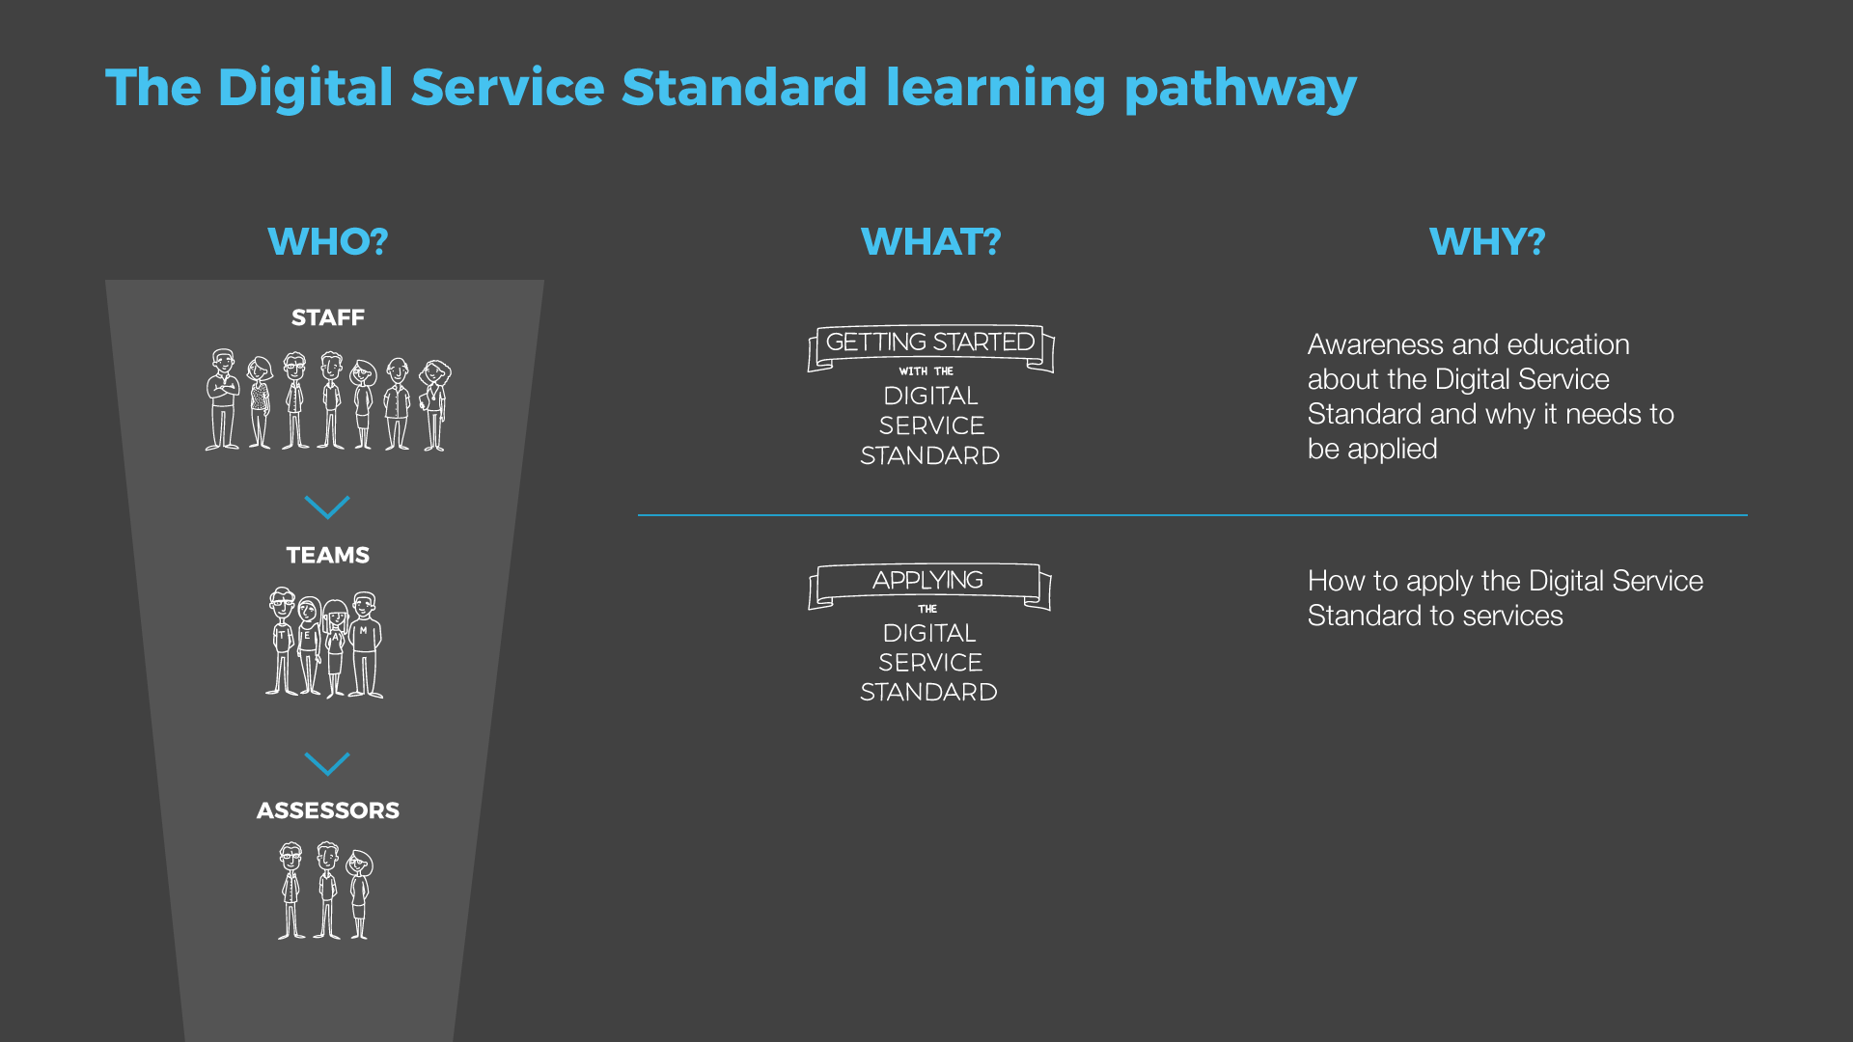

Slide 5
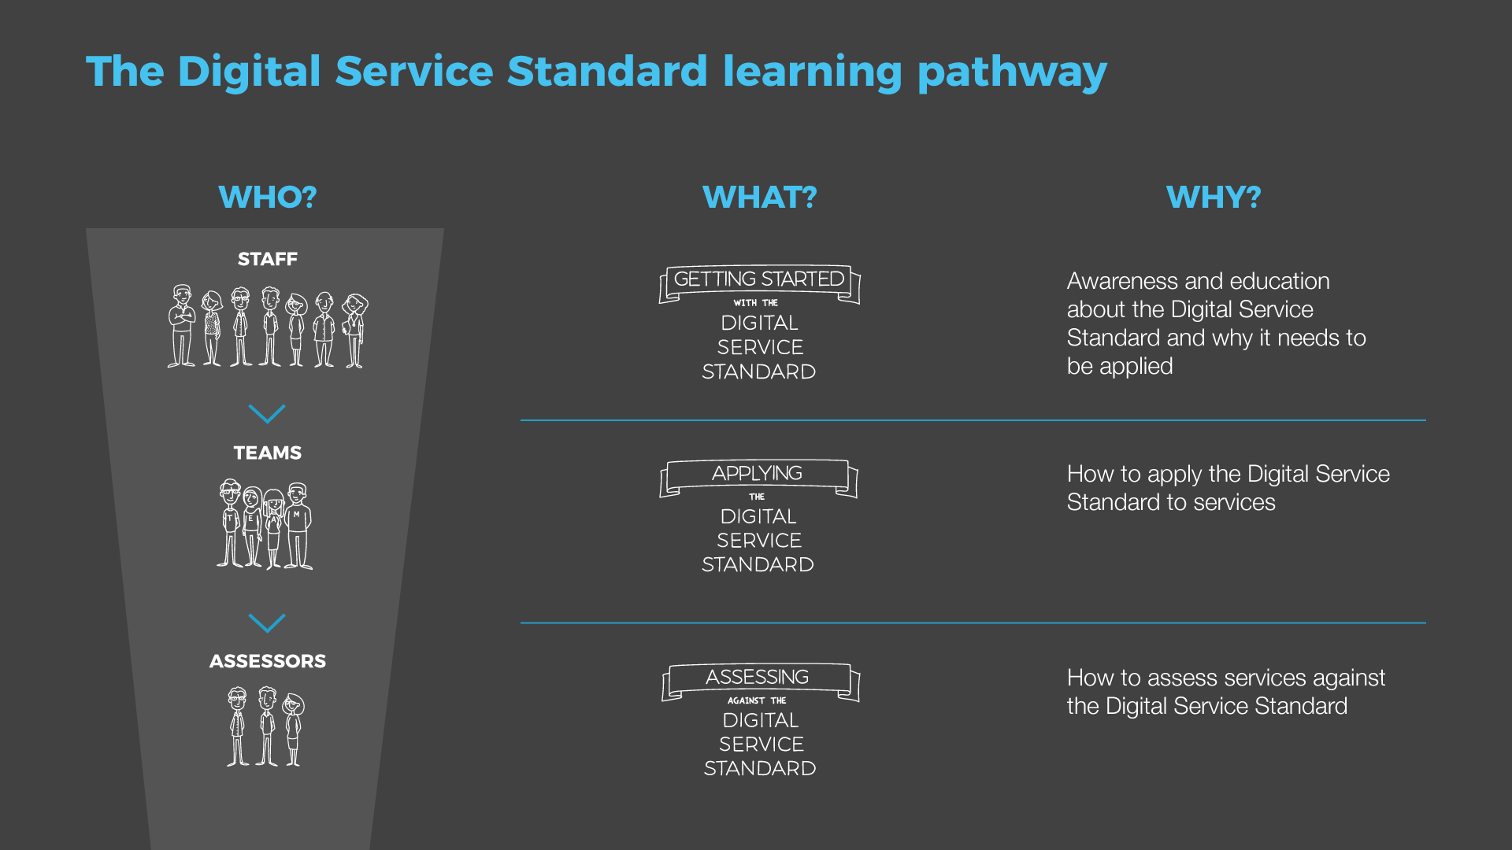

Slide 6
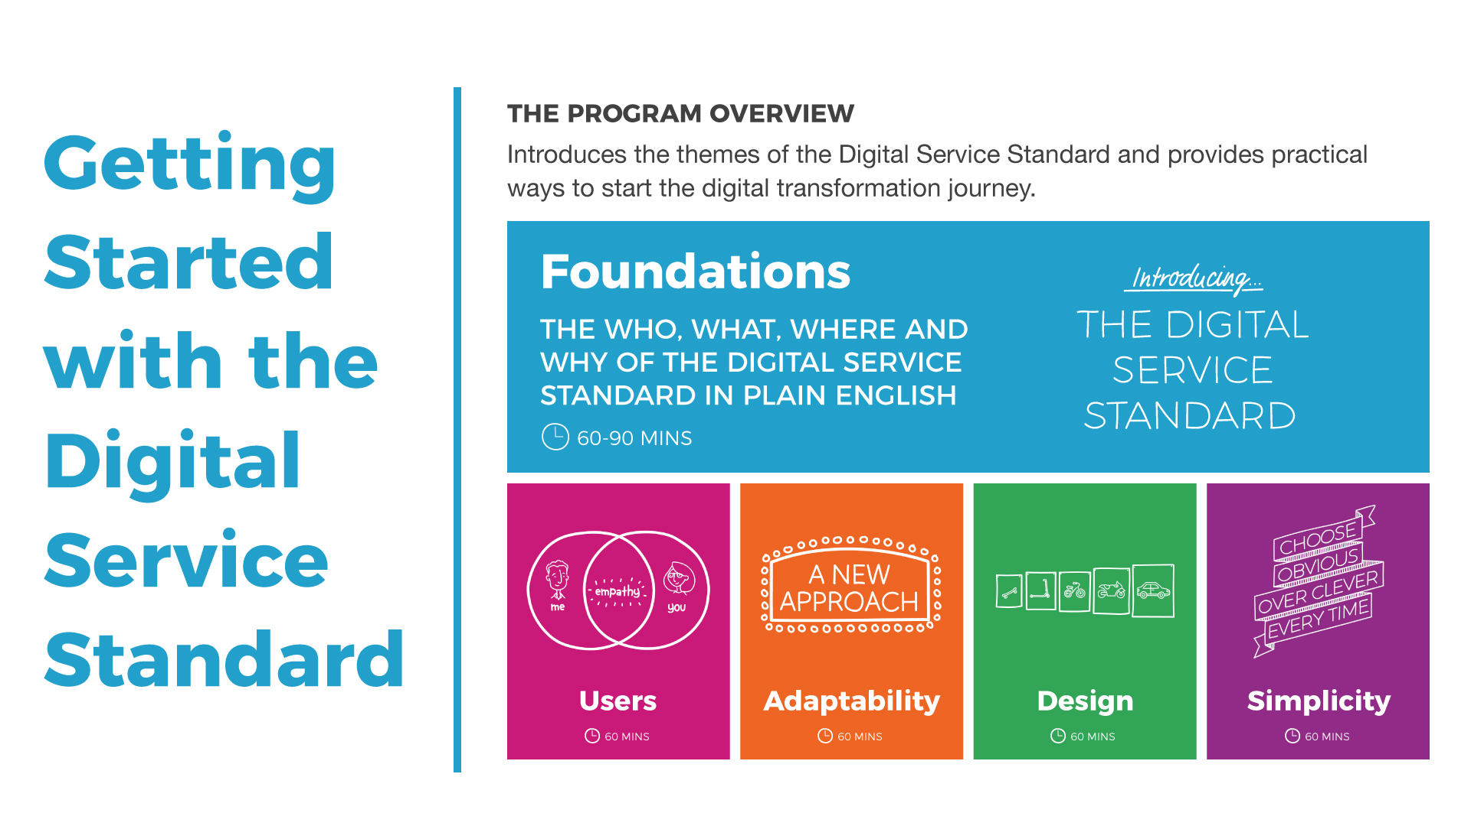

Slide 7
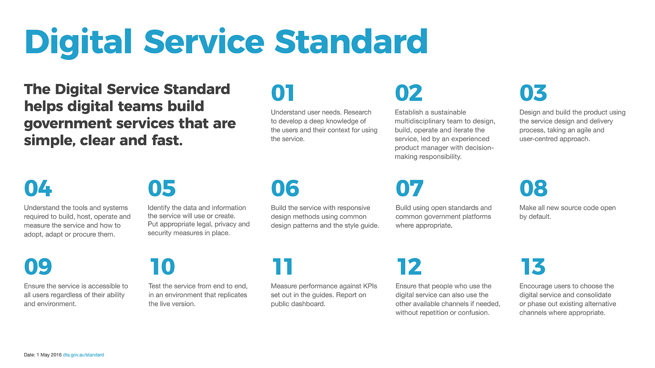

Slide 8
It’s not about building apps or websites
It’s about changing government to focus on user needs

Slide 9
What is a service?
Something that helps people get things done

Slide 10
Simple, clear, fast government services for everyone

Slide 11


Slide 12
Government commitment
PGPA Act non-corporate entities
public facing services
transactional
information

Slide 13
You must apply the standard
when
A new service is developed
A service is redesigned

Slide 14
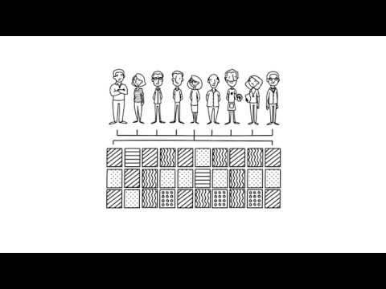

Slide 15
Key messages
The Australian Government is embarking on a process of digital transformation
The Standard helps us make services that are simple, clear and fast
We have an opportunity and responsibility to support transformation

Slide 16
Great services come from
understanding user needs
working in an adaptable way
designing the right solution
keeping things simple

Slide 18

Mind your mindset

Slide 19
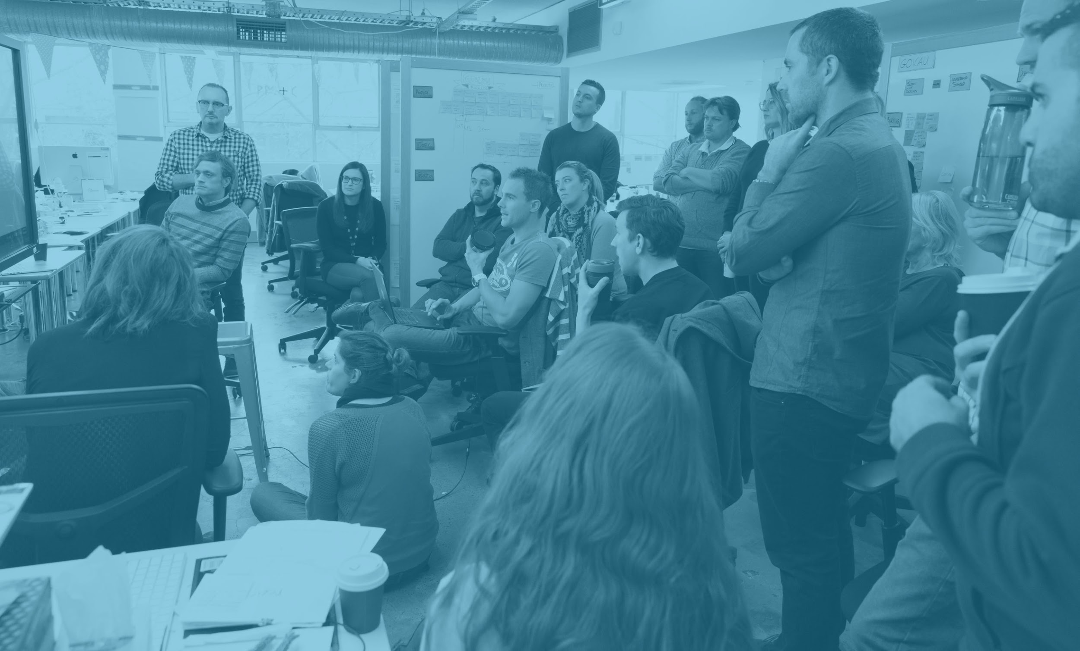
What’s next?

Slide 20

Users

Slide 21
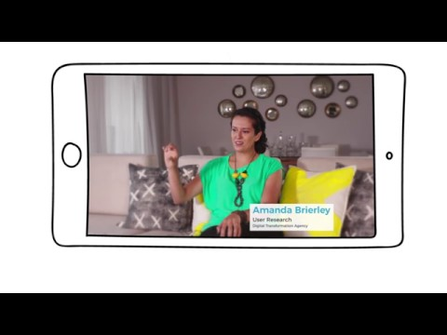

Slide 22
Key messages
We all have users
Good design puts users at the centre
Get to know your users and their diverse contexts first

Slide 23


Slide 24

Monty’s Story

Slide 25
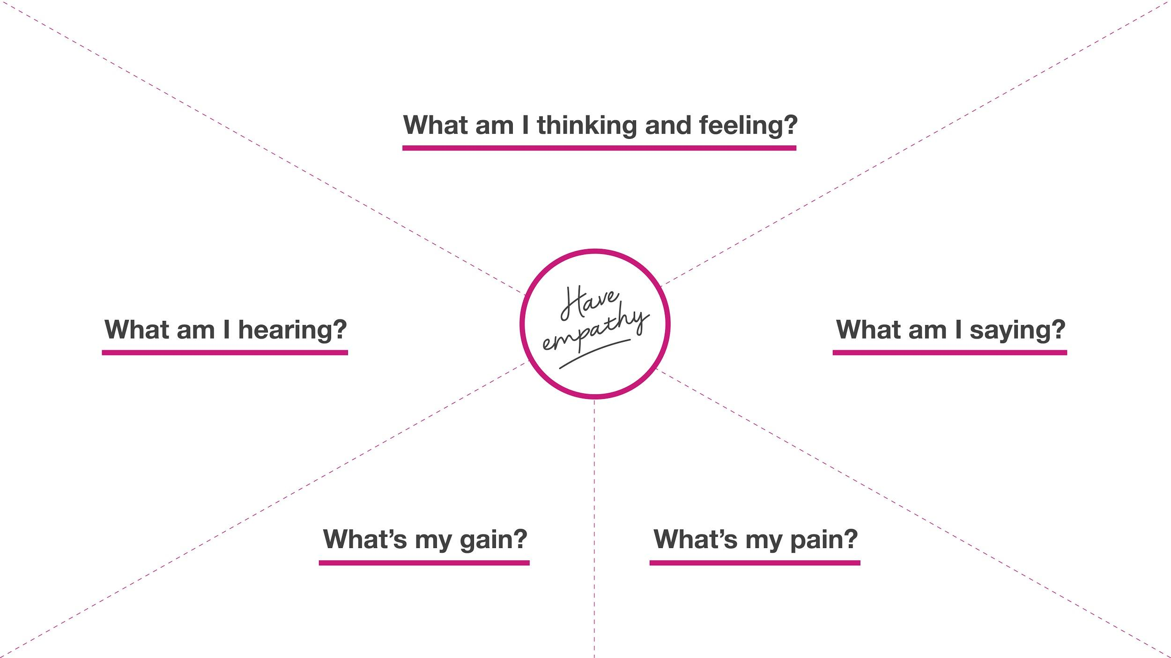

Slide 26
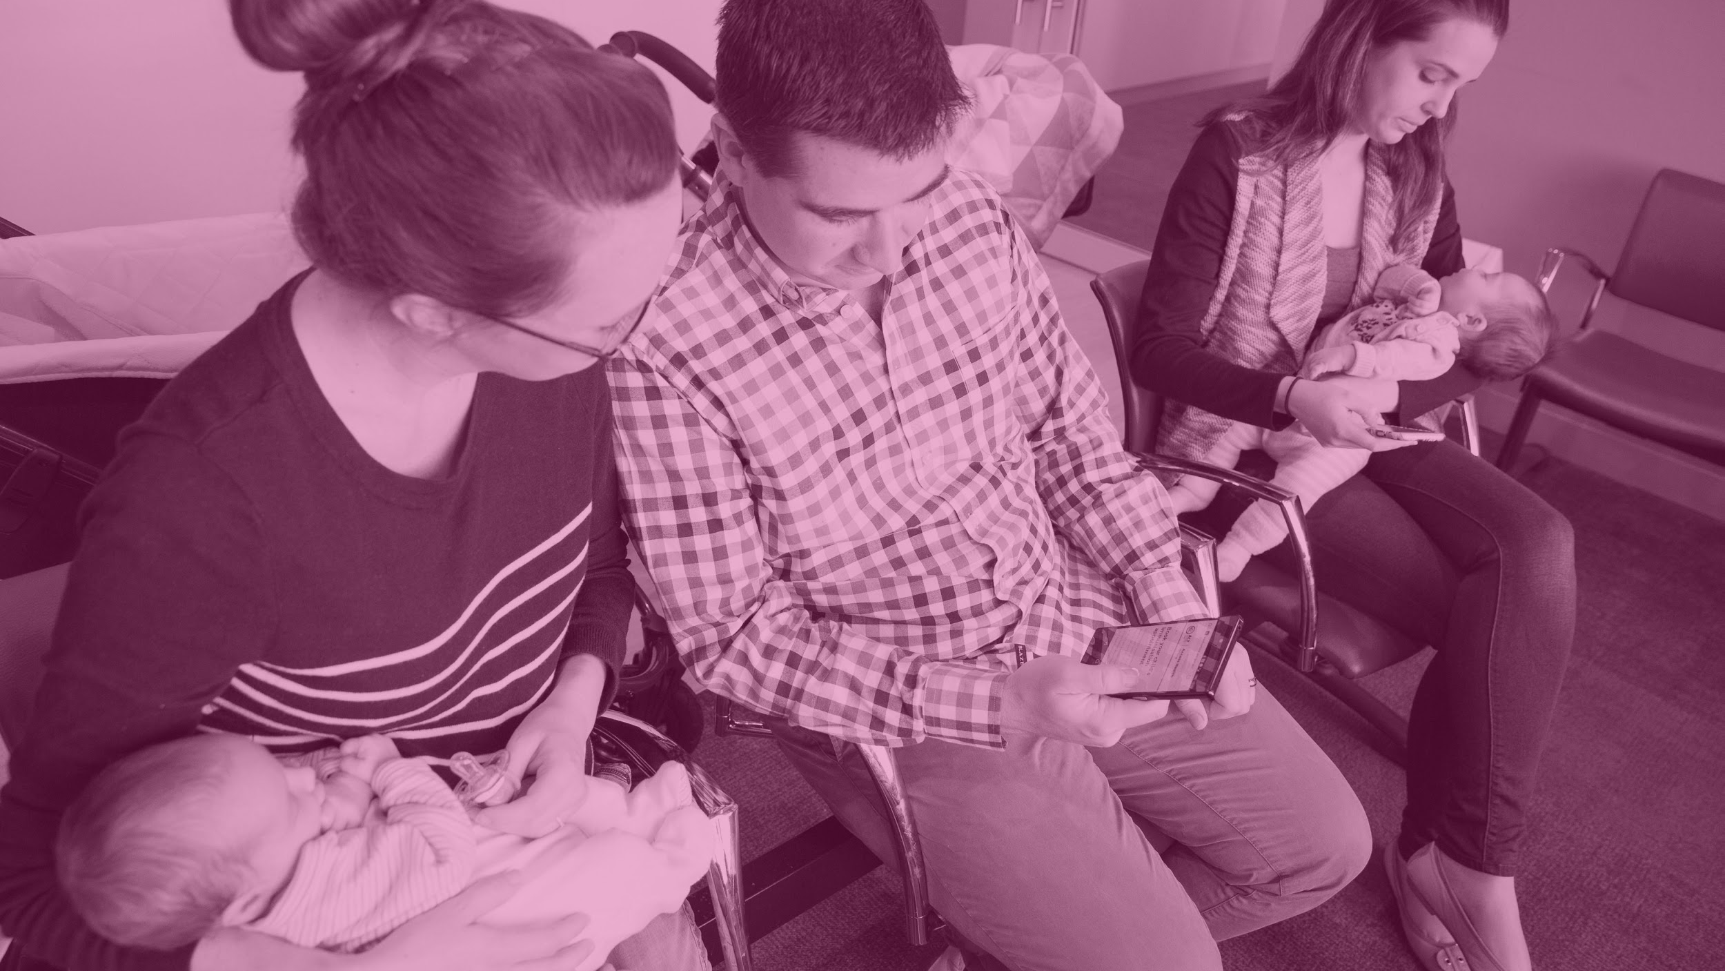
What’s next?

Slide 27

Adaptability

Slide 28
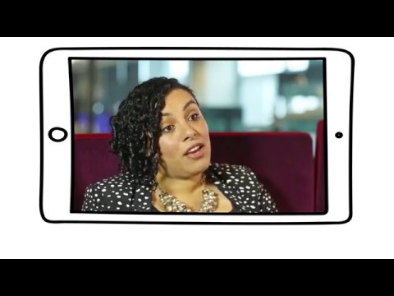

Slide 29
Key messages
We use an agile way of working
We build and deliver incrementally
Our decisions are driven by data

Slide 30

What’s your tee?

Slide 31
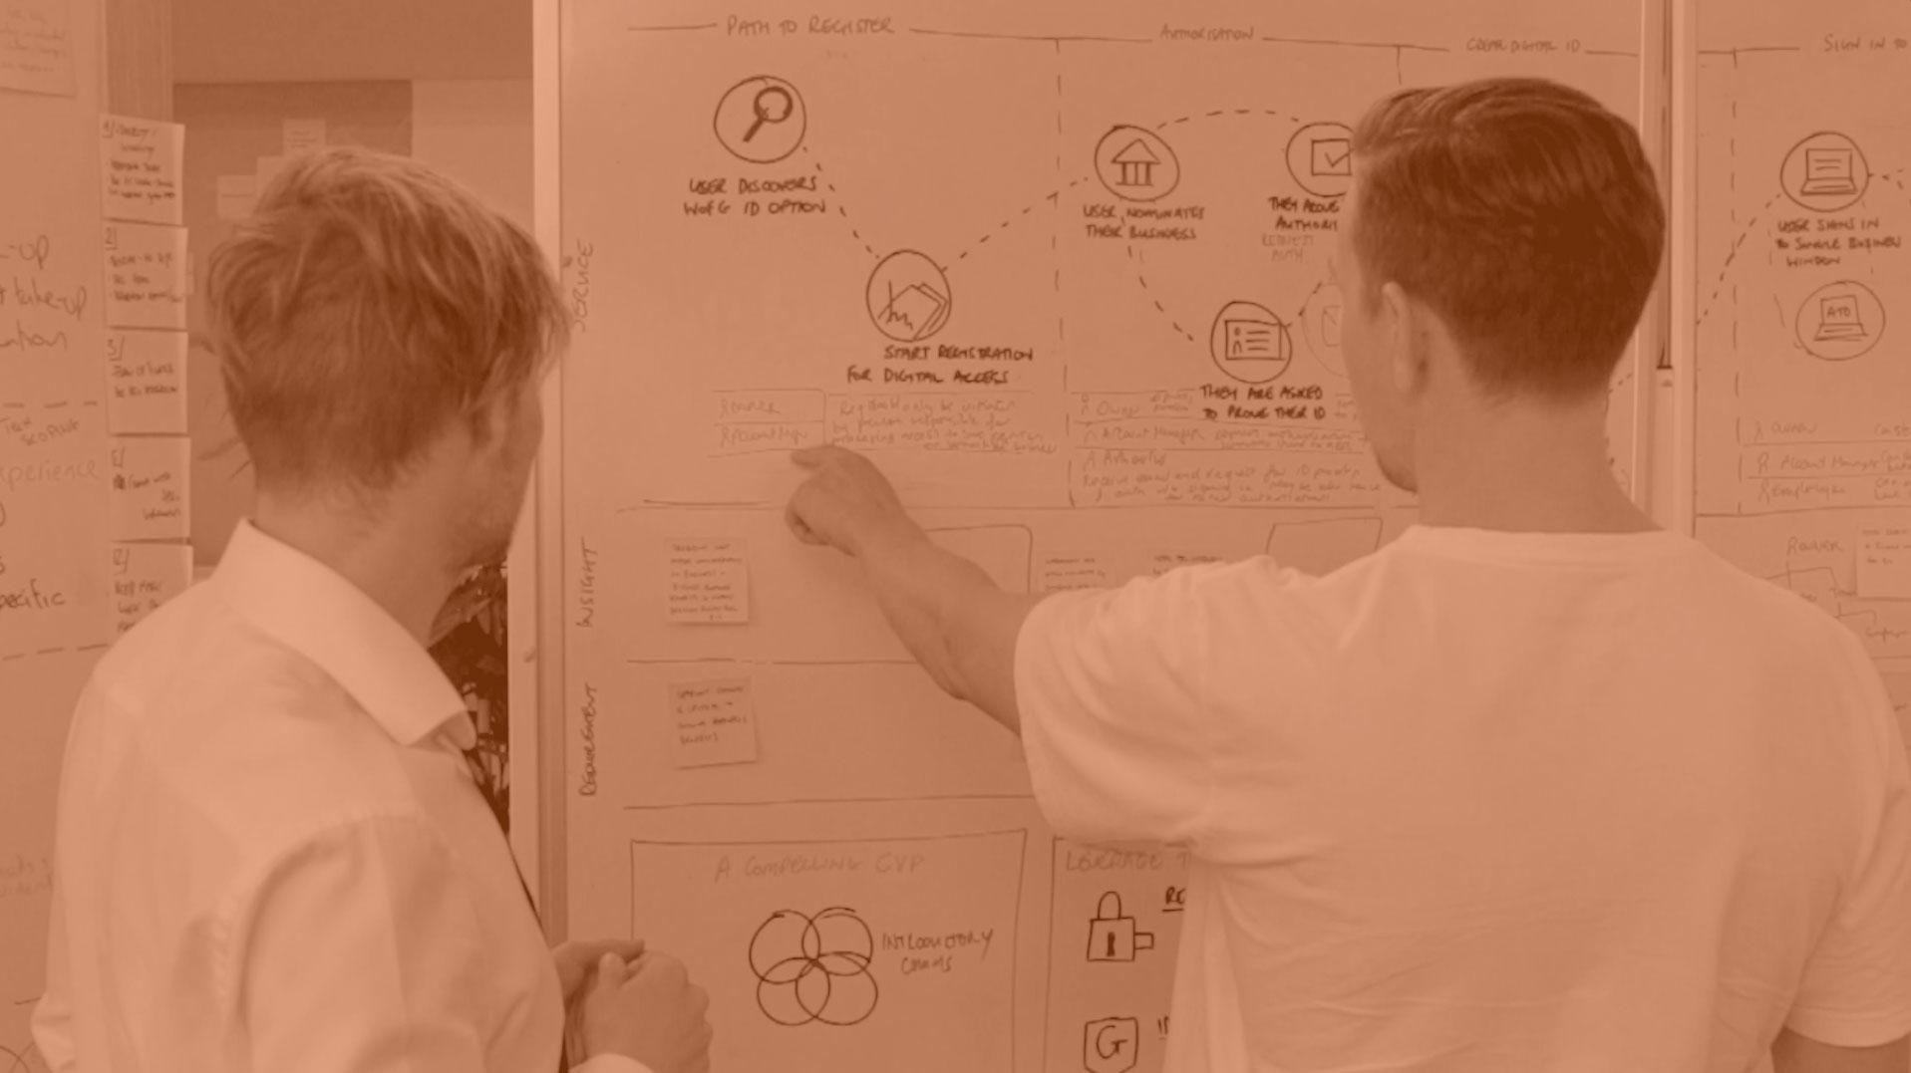
What’s next?

Slide 32

Design

Slide 33
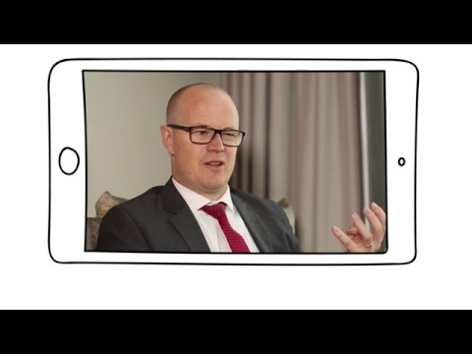

Slide 34
Key messages
We start with prototypes, adapting them as we test with users
We’re not afraid to fail fast and learn
By ensuring good design, we keep people safe

Slide 35
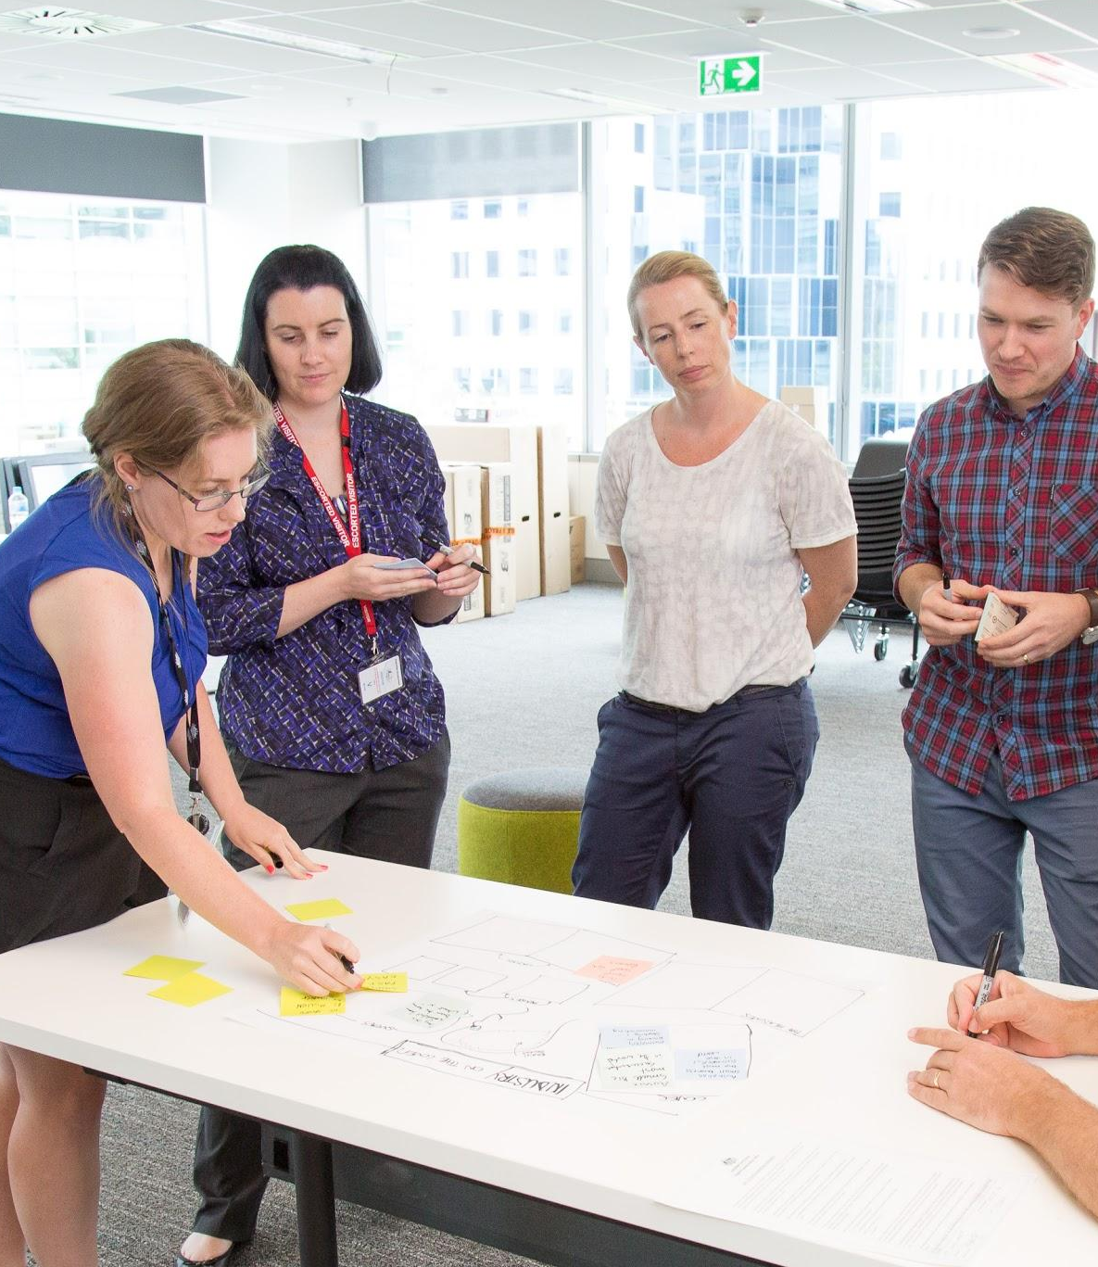
What does great service look like?

Slide 36

What’s next?

Slide 37

Simplicity

Slide 38
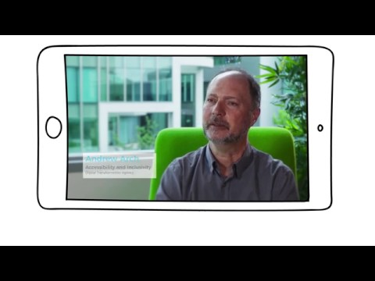

Slide 39
Key messages
Transforming services becomes easier when we share and reuse
We have a responsibility to make services simpler to use
We must do the hard work to make things simpler

Slide 40
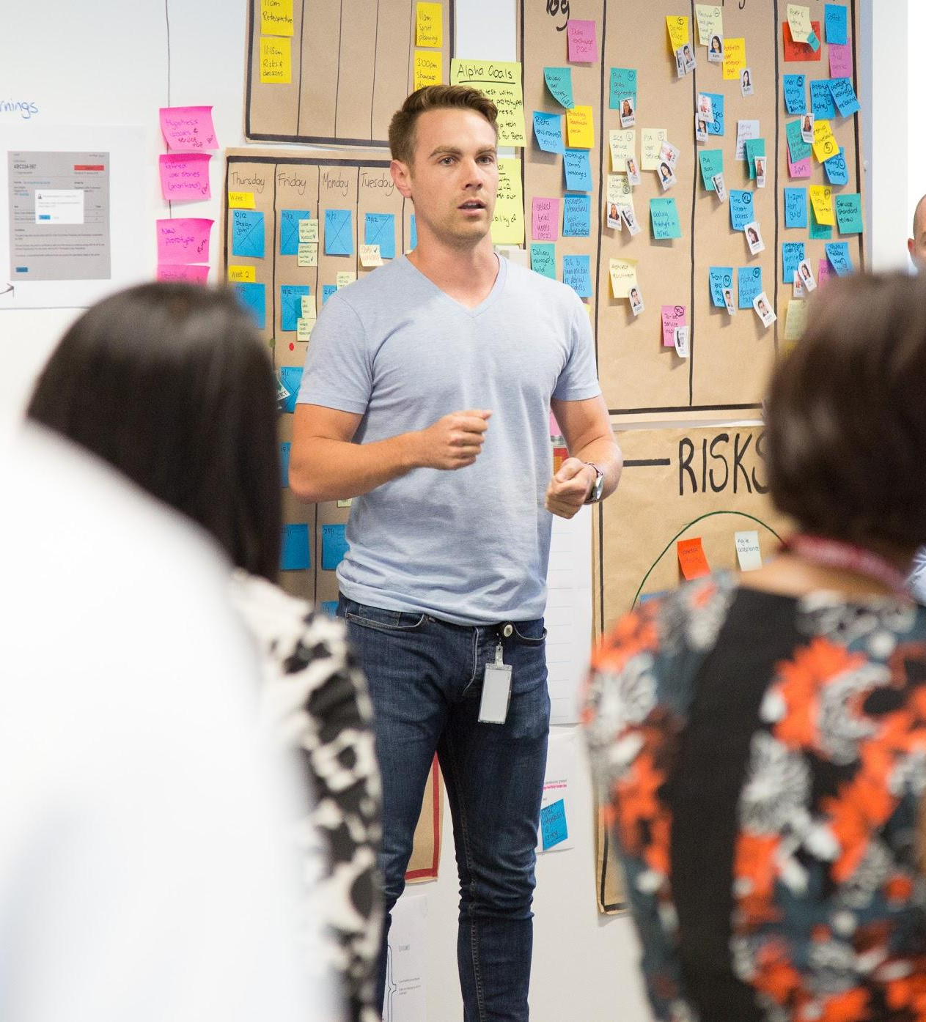
Elevator pitch

Slide 41

What’s next?

Slide 42

Conclusion

Slide 43
Great services come from
understanding user needs
working in an adaptable way
designing the right solution
keeping things simple

Slide 44
Simple, clear, fast government services for everyone

Slide 45
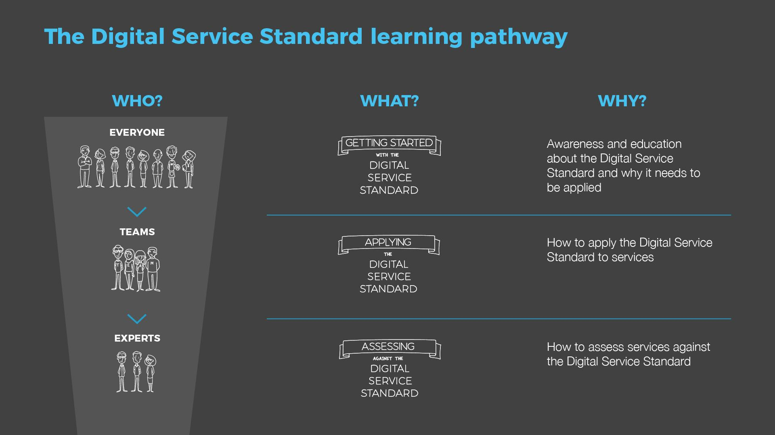

Slide 46


Slide 47
Thank you!
For questions or comments about the Standard, contact the team at standard@digital.gov.au

Slide 48

© Commonwealth of Australia (Digital Transformation Agency) 2017
With the exception of the Commonwealth Coat of Arms and where otherwise noted, all material presented within this training package is provided under a Creative Commons Attribution-NonCommercial (version 4.0) licence.

